Slide 1
Cluster Growth using the DLA Model
By Tahoe, Ksenia, and Xinmeng
Notes:
Hi, everyone! We are group4 and I'm Xinmeng Tong. My other group members are Tahoe and Ksenia. In this project, we are studying theories and simulations on random walk, diffusion, and cluster growth using the DLA model.

Slide 2
In this presentation:
2D Random Walks
The 1D Diffusion Equation
Diffusion Limited Aggregation Model for Cluster Growth

Slide 3
2D Random Walks
Notes:
I am going to talk a bit about the 2D random walks.

Slide 4
Analytical parameters for a 2D random walk
Notes:
For a 2D random walk, at each step, a drunk man moves to one of the four directions at a crossroad with equal probability of 1/4. Let's first take a look at the analytical parameters which will be used to check the validality of our simulation.
The mean value of x at step N is given by the sum of mean values over all steps, which is 0 by explicit calculation.
And the mean squared value in x direction can be splited into two terms, the squared term and the cross prodeuct term, where the second one is zero, so that we convert again to the mean of a independent walk which is 1/2 so the mean square is 1/2 N.
If we want to study how much the particle is shifted from the origin after n steps, the mean squared distance is a good measurement, which, due to the independence of x and y direction, is N.

Slide 5
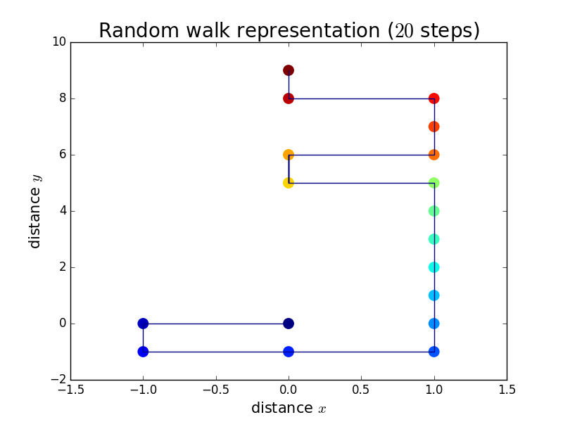
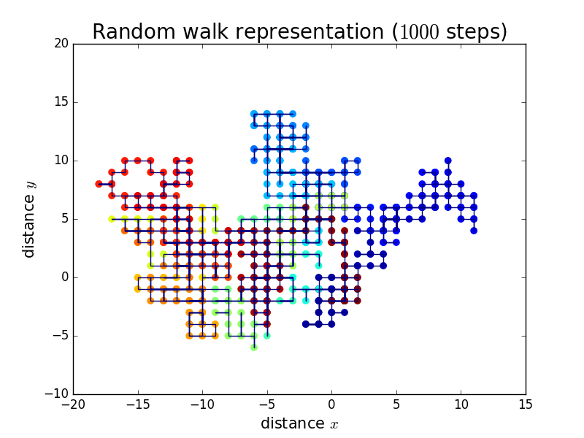
Simulation of 2D Random Walk
Define random-walk function using 4 thresholds in random numbers among (0,1)
Record position and displacement infor-mation for each step
Average over 10,000 different walkers
Notes:
So how do we establish our python code to simulate such a 2D random walk?
First we define a random-walk function which tells us the direction of a movement for each step, by using inserting 4 thresholds in the randomly generated numbers between 0 and 1.
And we let walker evolve with time(steps), record the position and displacement information for each step so that we keep a clear track of our walker.
What's more, we need to average over 10,000 different walkers to gt a better result.
Notice that for a small number of steps, the direction of evolution is very unstable . As steps go up, it stends to spread out more but the shape is also irregular and undetermined.

Slide 6
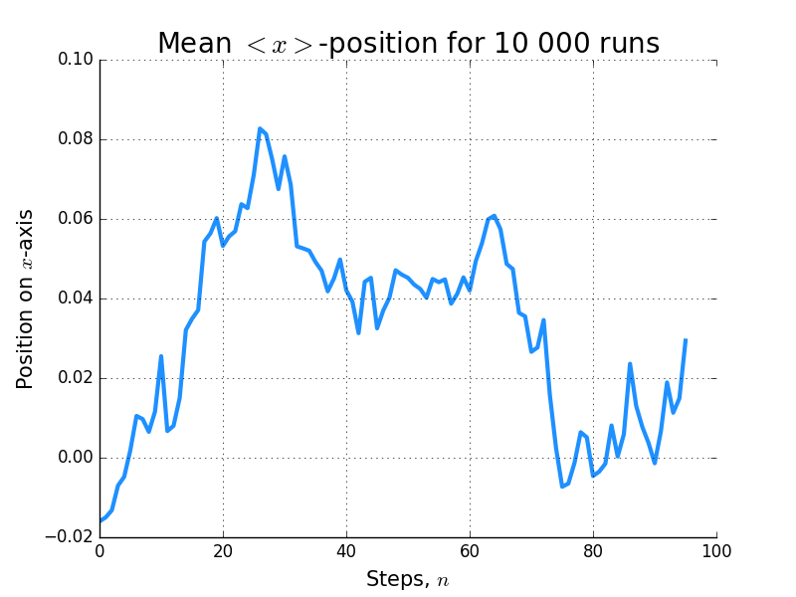
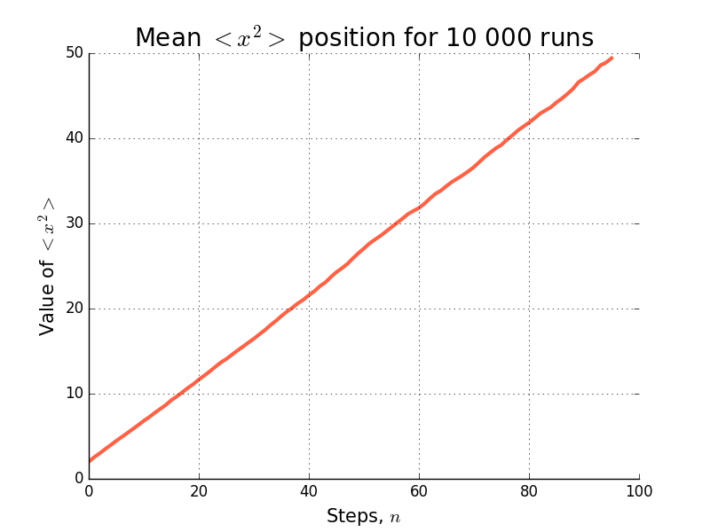
Simulation of 2D Random Walk

Slide 7
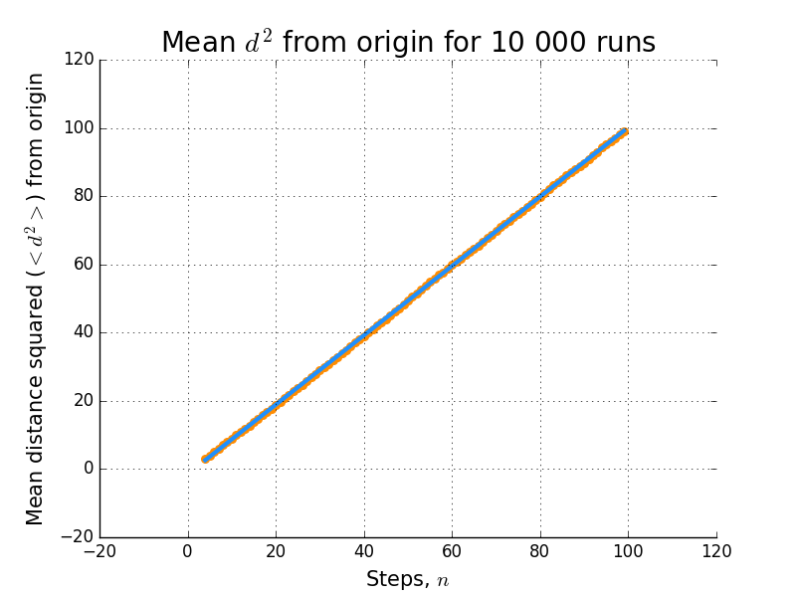
2D Random Walk is diffusive
Diffusive motion has
For 2D R.W. our simulation gives the relation
Thus, the diffusion coefficient is given by D=0.25.
Notes:
We know that if a motion is diffusive, it satisfies that the mean square distance is proportional to time.
In our simulation, it is obvious that the mean square distance that a random walker travels is proportional to step numbers. So if we set the random walker at constant speed, then each step will corresponds to a unit time. Then we could actually prove that the 2D random walker is diffusive.

Slide 8
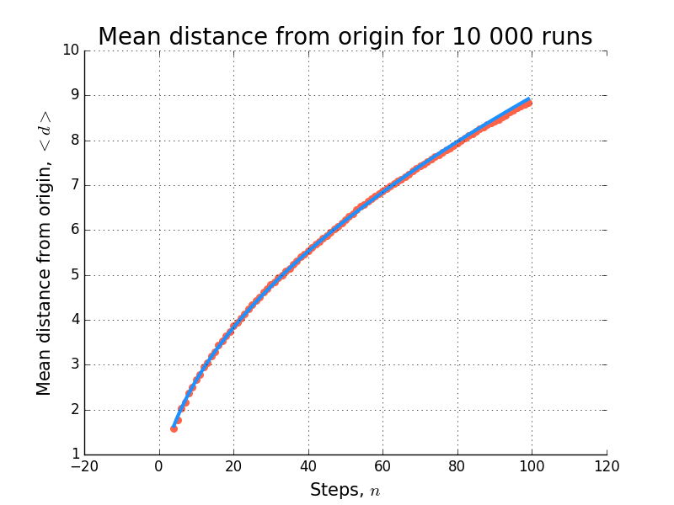
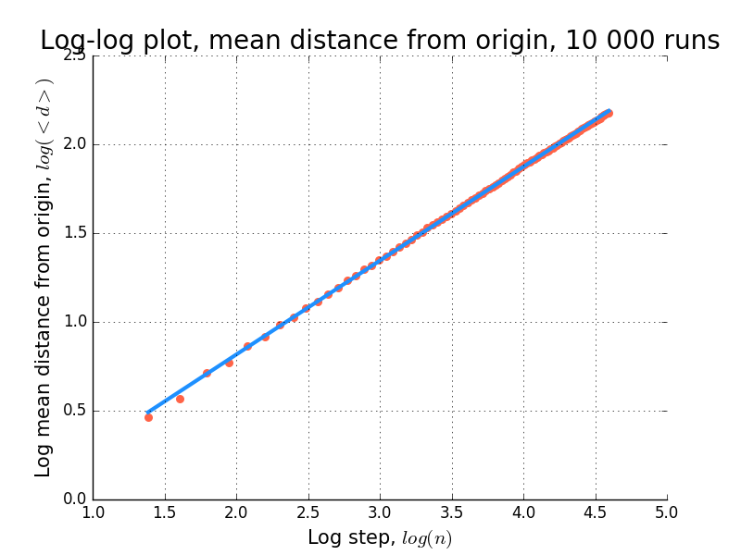
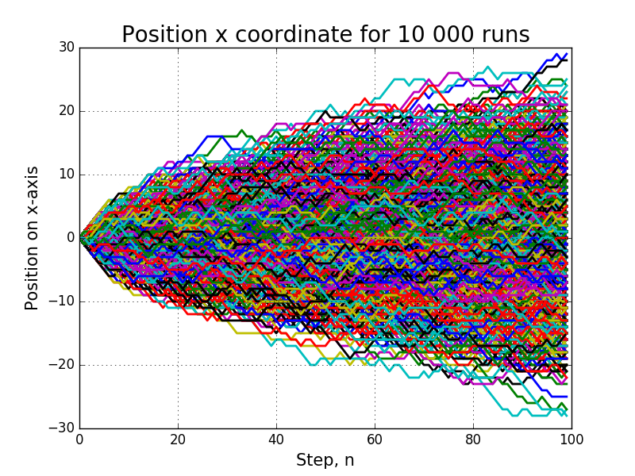
Simulation of 2D Random Walk - Plots of interest

Slide 9
1D Diffusion Equation Solver

Slide 10






Modelling the Equation
Differential Form
Finite Difference Form
Time dependent diff. eq.
For a box density, later solutions should be Gaussian
Convert to an iterable form
Algebraically manipulate formal derivatives
For our purposes, D=2 and stability is guaranteed by

Slide 11

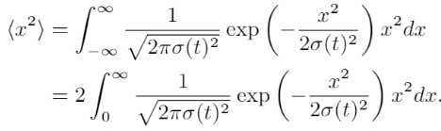


Variance of a Gaussian – Quick Proof
Expectation values are of the form:
Thus, after using the fact that we are dealing with an even function
After a change of variable
Finally, after integrating by parts:

Slide 12
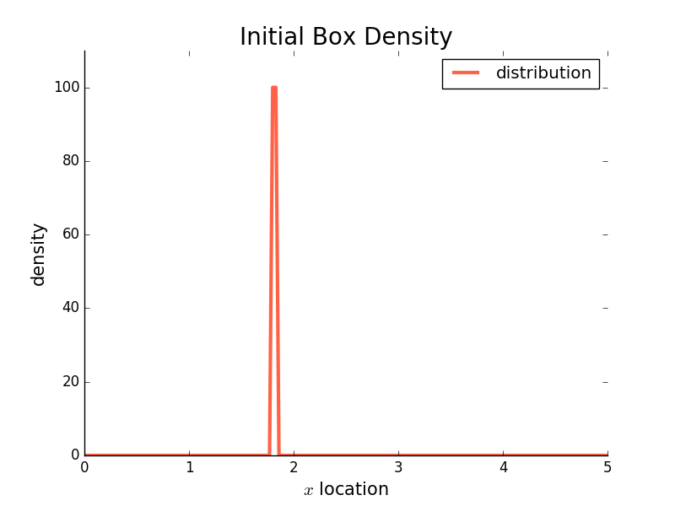
Initial Distribution
Important to put the box density far from the edges, otherwise you will affect the Gaussian and make it lopsided.

Slide 13
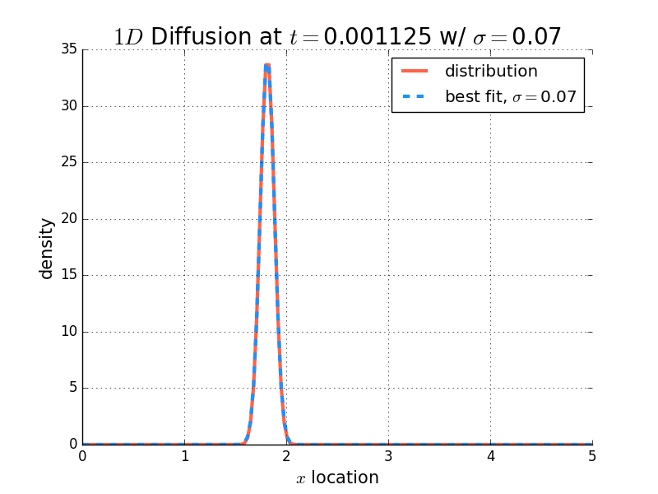
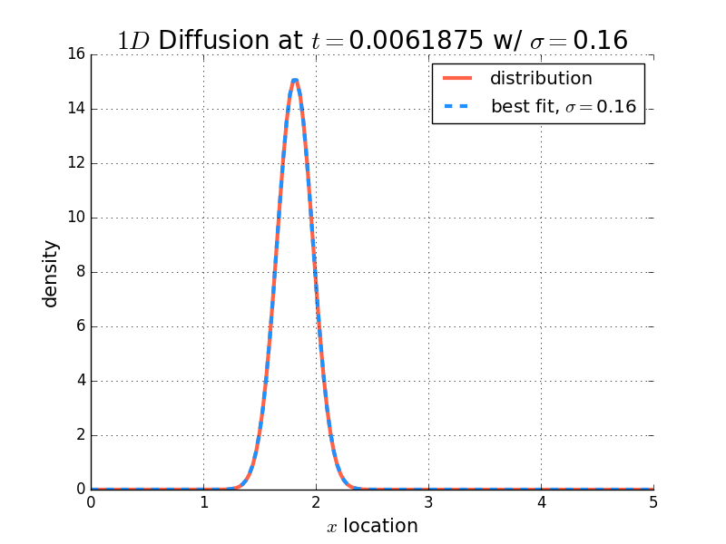
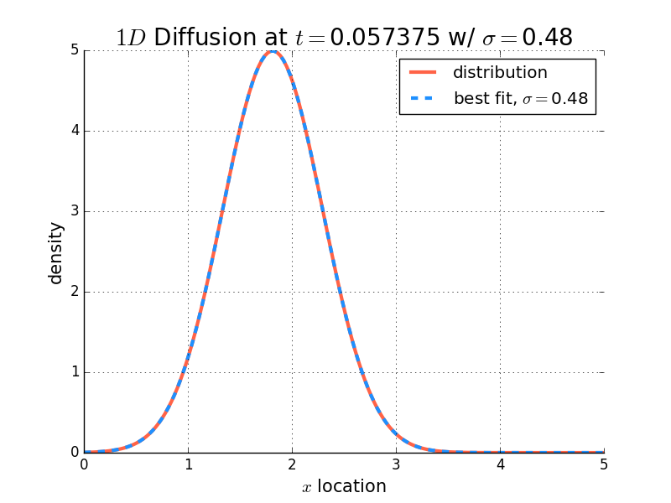
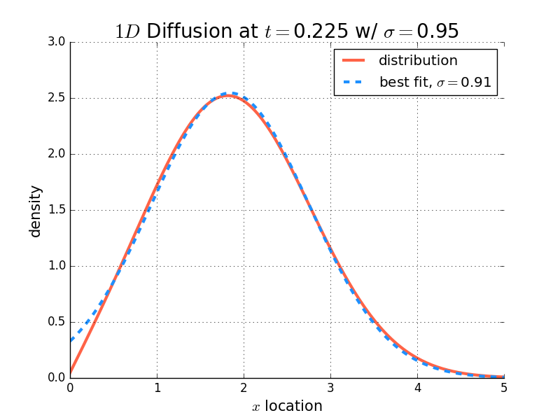

Four Evolutions in Time
A sigma fit was performed for each time snapshot, and they match very well with the expected:
Note: Edge effects distorting the fit at later times.

Slide 14
Cluster Growth using DLA

Slide 15
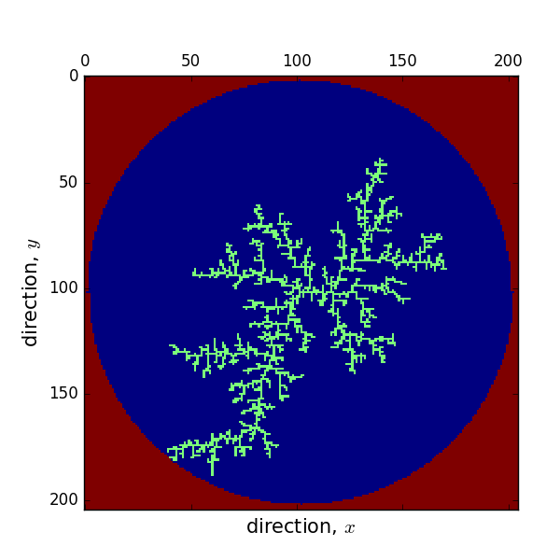
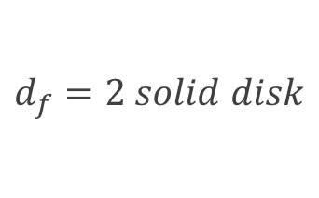
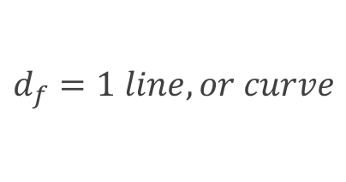
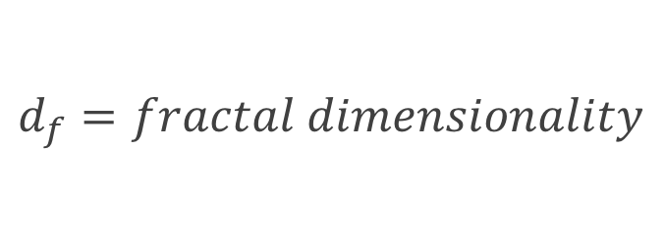

DLA Cluster
Many large open spaces, irregular perimeter
$$\text{m}\text{(}\text{r}\text{)}\sim r^{d_{f}}$$
$$d_{f}=fractal dimensionality$$
$$d_{f}=1 line, or curve$$
$$d_{f}=2 solid disk$$

Slide 16
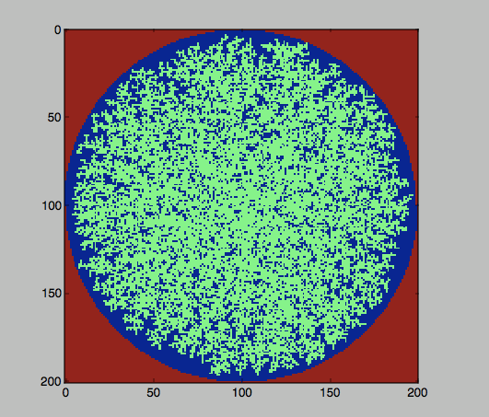
Eden cluster

Slide 17
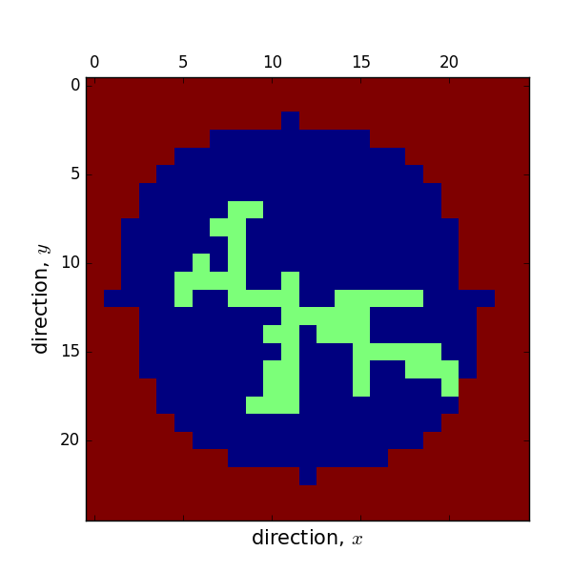
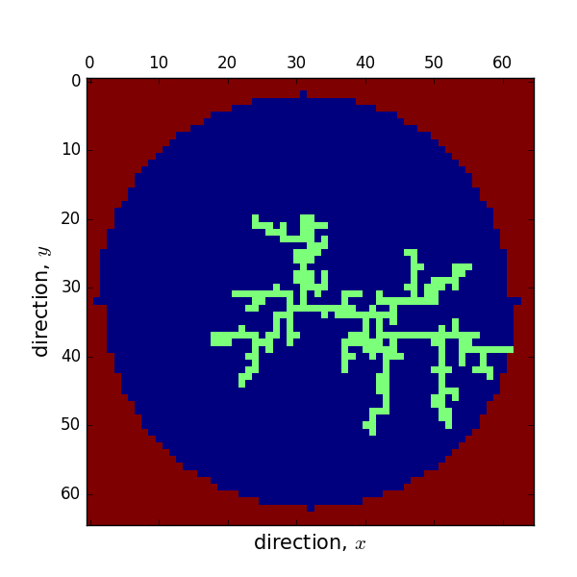
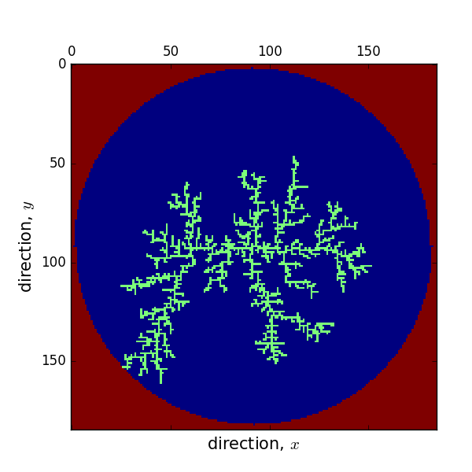

Slide 18
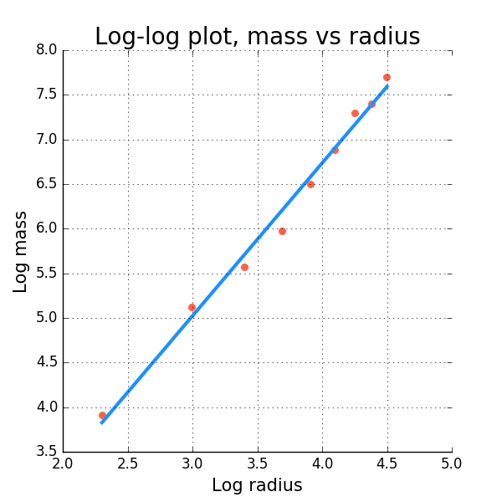


Fractal dimensionality
$$\log{m=d_{f}log⁡(r)}$$
In 10 runs fractal dimensionality:
2.067, 1.653, 1.877, 1.833, 1.607, 1.832,1.782, 1.712, 1.843, 1.862
$$d_{f}=\text{1.712}$$
mean=1.807

Slide 19
Thank you for your time!

